Slide 1
Electric Motor Temperature
Group 2 R Language
Varun and Byom
<28/01/2020>

Slide 2
Business Problem:
Motor speed is the output/dependent variable influenced by all other independent variables and we can see the dataset through EDA (Exploratory Data Analysis) how it flows.
Objective:
Predict Motor temperature based on other attributes available are like ambient, coolant, torque, current d_q components, voltage d_q components, stator yoke, stator tooth, stator winding, permanent magnet and profile_id.

Slide 3
Project Architecture / Project Flow
Business problem
Exploratory Data Analysis
Model Building
Model Evaluation
Deployment

Slide 4
Exploratory Data Analysis (EDA) and Feature Engineering
Data set details
There are 6,98,649 rows and 14 columns in the dataset
there are no NA values in the given data set.
Data set follows the normal distribution.
Check all the business moments.
Majority of the variables are right skewed and has long tail in the end.
And others are left skewed and has long tail in the beginning.
We will remove the 1st variable because it’s a serial number.
The target variable is Motor Speed , PM and others are input variables.
When we check the structure of the data set except profile_id others are numeric. Now we have to convert profile_id into factor.

Slide 5
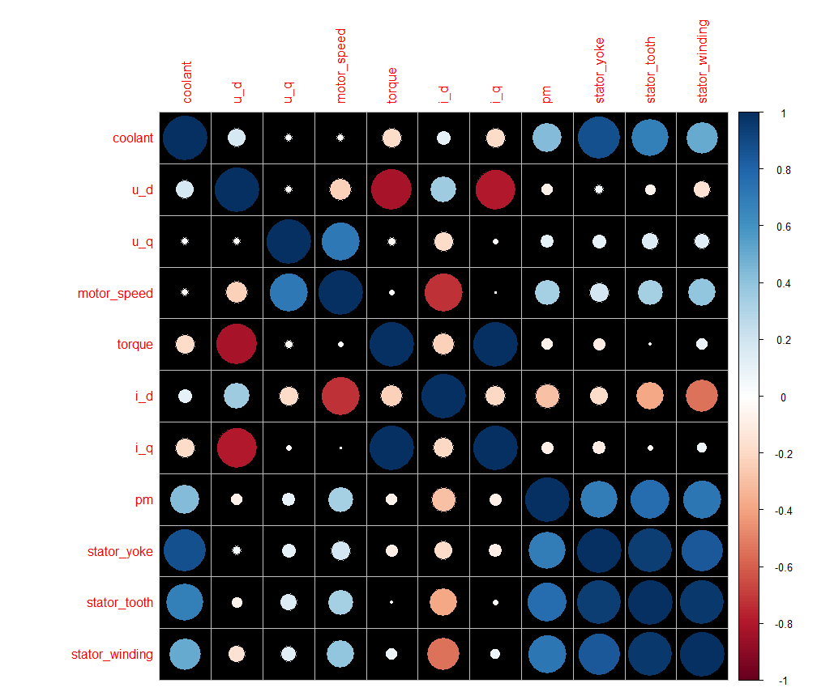
After converting into factor we will get 52 levels.
Now find the correlation between the variables. There is a collinearity also.

Slide 6
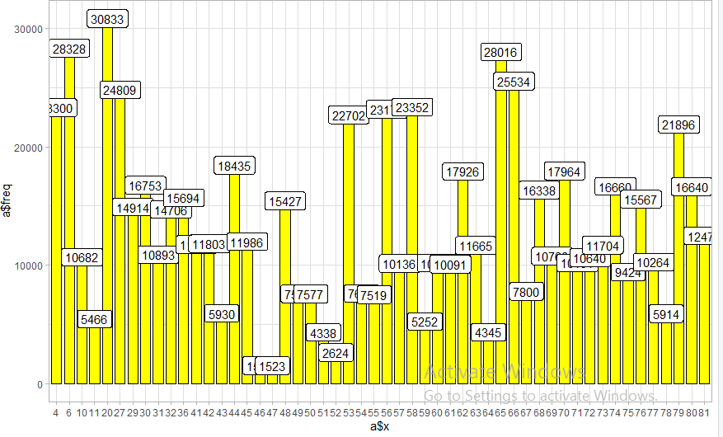
Now make profile_id to unique so that we will come to know how many unique profile_id is there in the given dataset.

Slide 7
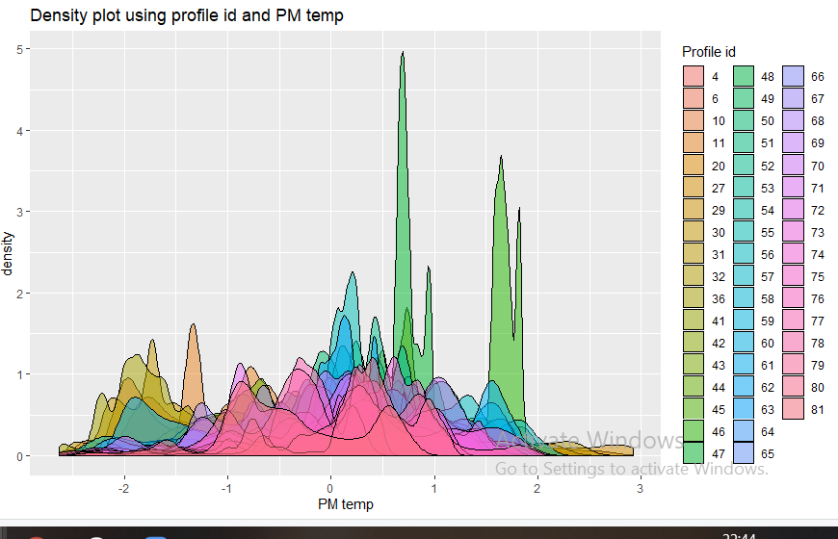
By using density plot we will come to know about how much space each variable has occupied.

Slide 8
Histogram and bar plot will help us to find the variation in the data set.
Scatterplot will help us to know whether the variables will follow positive or negative linearity.
All the variables follows positive linearity.
Heat plot will tell us whether there are any NA values and correlation of the variables.

Slide 9
MODEL BUILDING

Slide 10
We have divided Training data into train and test with ratio 70:30
Based on this data we are going to perform model building.
Multi linear regression :
Residual standard error is 0.5
Multiple R square value is 0.7498 which means model is average.
Accuracy is 86%
RMSE value is 0.499.
In this model we have high accuracy and high RMSE value.

Slide 11
RIDGE REGRESSION :
RMSE value is 0.503
Accuracy is 86% which means model is good.
In this model we have high accuracy and high RMSE value.
LASSO REGRESSION :
RMSE value is 0.5001
Accuracy is 86%
In this model we have high accuracy and high RMSE value.
ELASTIC REGRESSION :
RMSE value is 0.499
Accuracy is 86%
In this model we have high accuracy and high RMSE value.

Slide 12
DECISION TREE :
RMSE value is 0.6067 which is high.
Accuracy is 79% which means model is good.
In this model we have high accuracy and high RMSE value.
RANDOM FOREST :
RMSE value is 0.0732 which is very low.
Accuracy is 98% which means model is good.
In this model we have high accuracy and low RMSE value.

Slide 13
We have done 6 model for the given data set.
In those model we have to select the model which has high accuracy value and low RMSE value.
Almost every model’s RMSE value is more compared to Random Forest.
By considering above condition we can use RANDOM FOREST, which has high accuracy value of 98% and low RMSE value of 0.0732 as final model.

Slide 14
Thank you

